Slide 1
Demand Paging
How to approach the problem?
*Slides include material from CSC 501 SPRING ‘20

Slide 2
Where to Start?
Read the assignment two - three times.
Understand how demand paging works. Address Translation example for Intel Processors (By: Joe Pfeiffer)
Read about control registers. Intel System Programming Manual
Go through the code skeleton provided (the paging folder).
Logically break down the problem.

Slide 3
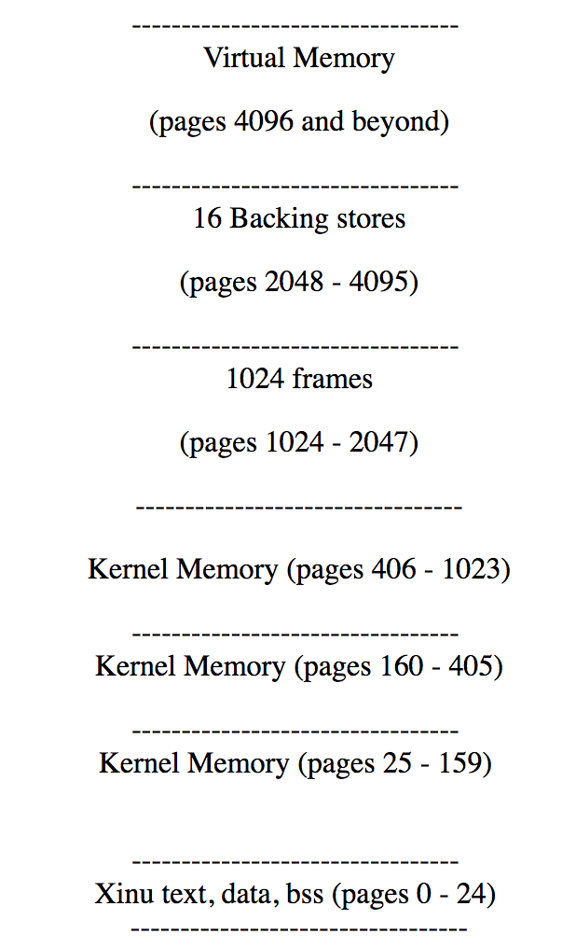
Xinu Memory Layout

Slide 4
Paging: Page Tables/Directories
Residing in frames 1024 – 2047
4 global page tables for the first 16MB memory shared across all processes( Created during system initialization
On-demand allocation of page tables for pages > 4095 4MB physical memory required for the whole 4GB virtual memory space

Slide 5
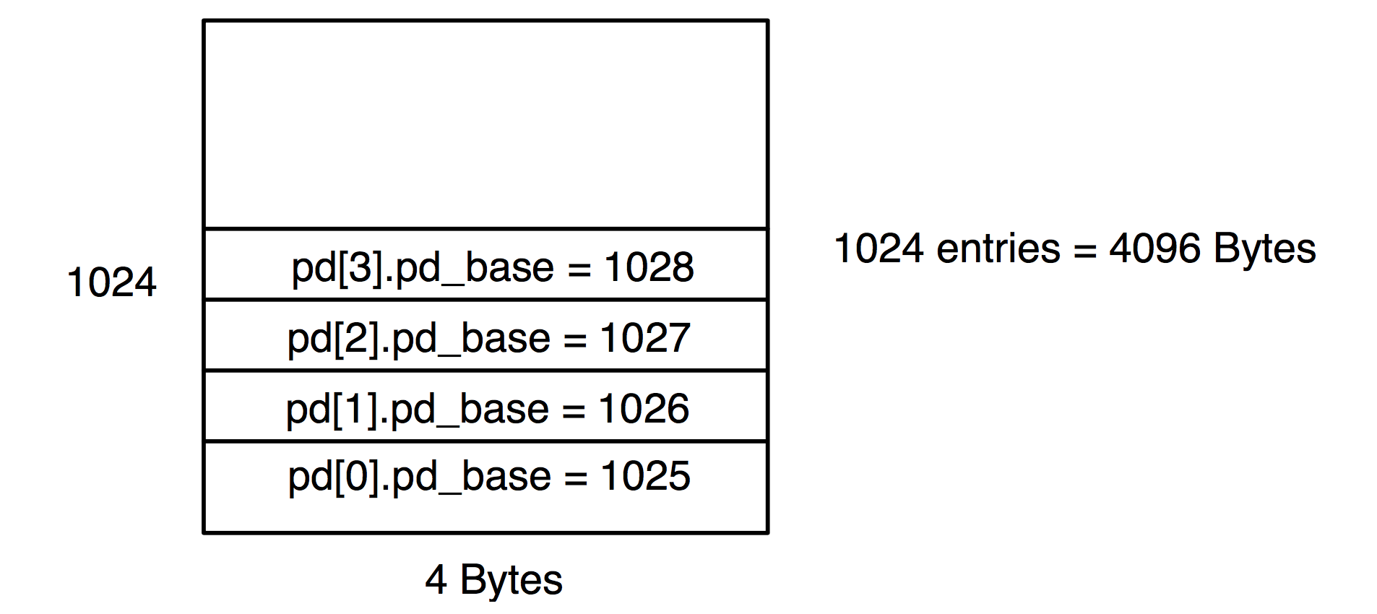
Page Directory for Null Process

Slide 6
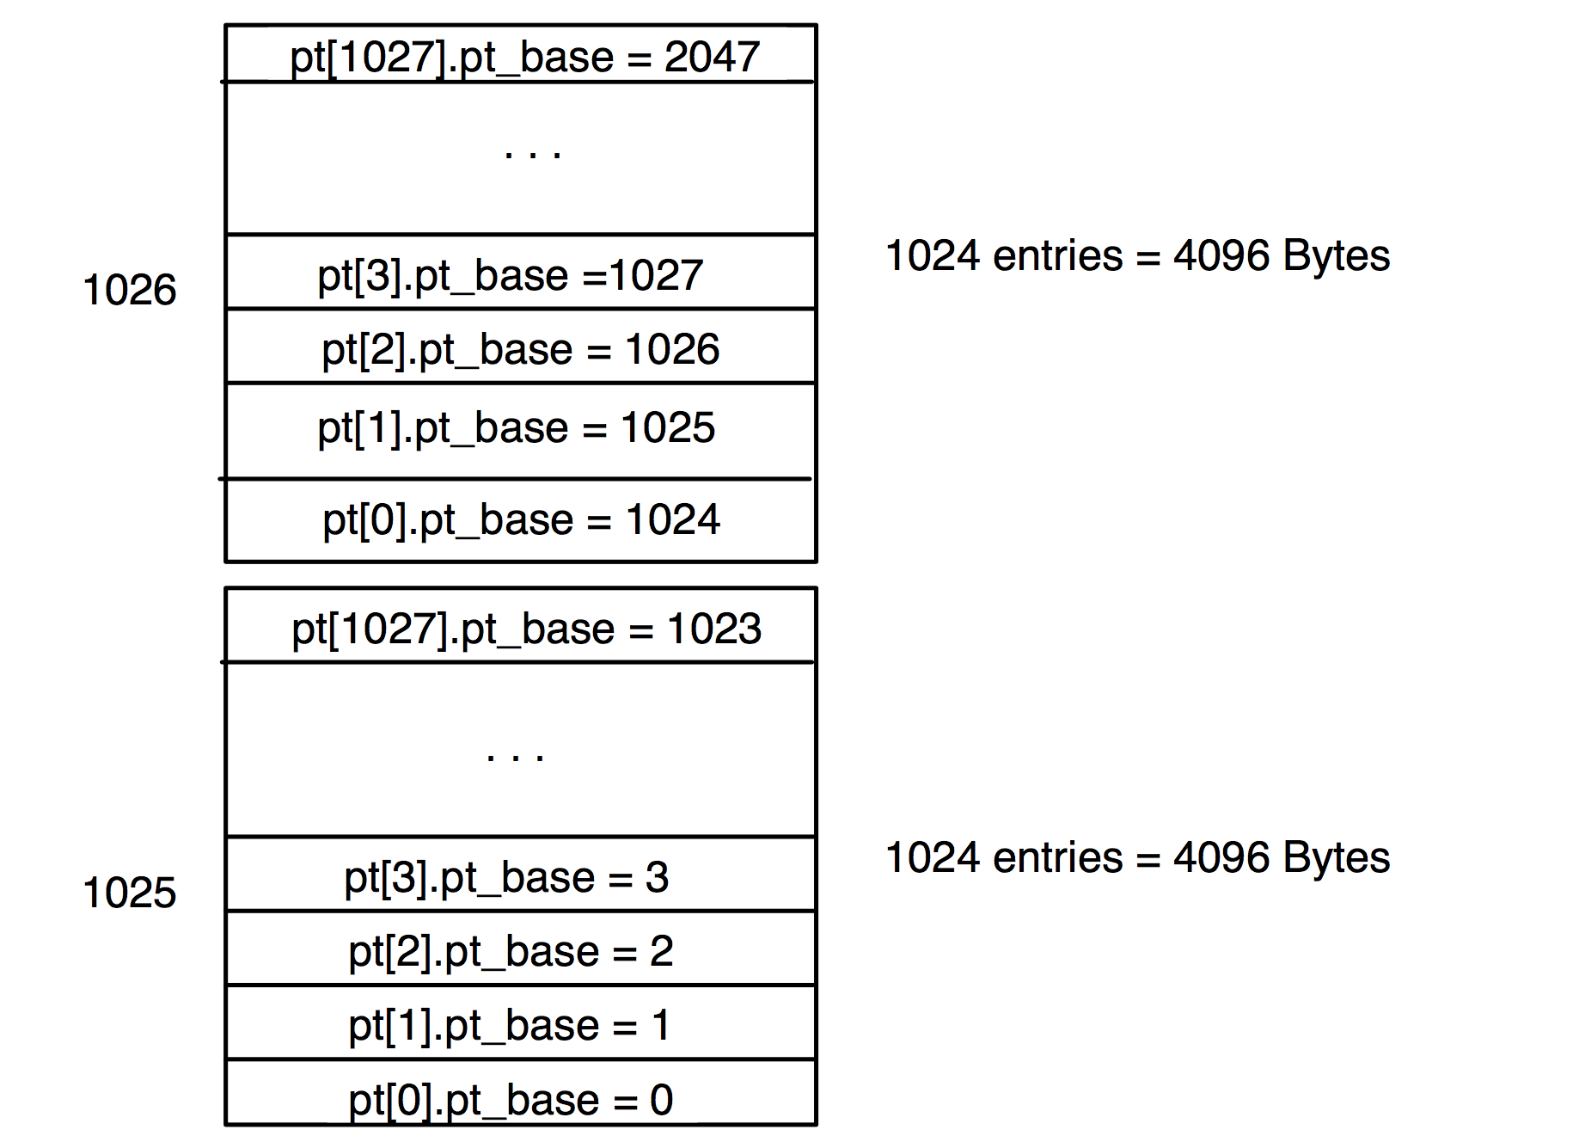
Global Page Tables

Slide 7
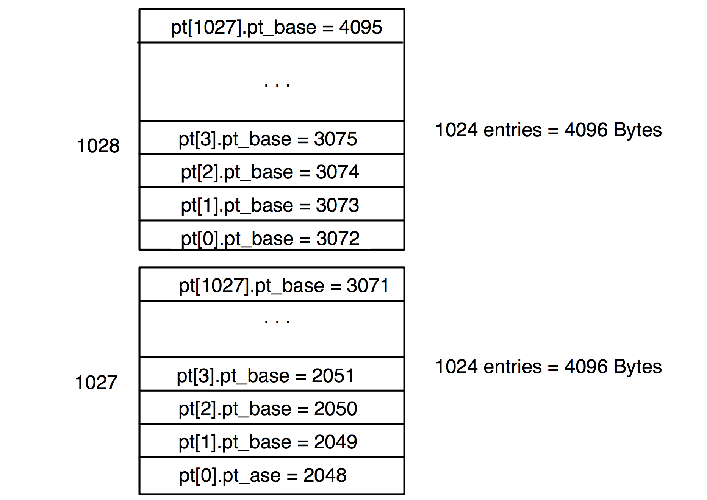

Slide 8
Demand Paging Flow
Set up global page tables.
Create a page directory for the process and save the pdbr in pentry.
On Context Switch, update PDBR /control register.
When the process starts executing
Instructions fault on code and data pages.
Faulting stops when all necessary code and data pages are loaded in memory.

Slide 9
Logical breakdown
Backing Store and Mappings
Paging
Replacement Policies
Initialize, mapping, releasing, lookup a BS.
(bsm.c, get_bs.c, release_bs.c, xm.c,
vcreate.c)
Initialize the system:(i386.c, initialize.c)
Setup global page tables and proc page directory.(frame.c)
Enable Paging
Set up ISR(pfint.c,pfintr.S)
Virtual heap (vgetmem.c, vfreemem.c)
SC (default) and LFU (policy.c)
Part 1
Part 2
Part 3

Slide 10
Mid Submission
6th April
Try finishing Part 1 and Part2

